Slide 1
Global Acceleration Program (GAP)

Slide 2
We break down borders
through commercial ties that support the economic development of your company.

Slide 3
Parque Tec
in the world
The alliances and opportunities that it has built in its almost 20 years of dedication to dedicated to empowering talent, allow to this day the economic and social development of entrepreneurs, entrepreneurs, startups and entrepreneurs.
Thanks to its experience, it is a benchmark in the startup ecosystem in startups ecosystem in LATAM, where it empowers
companies with constant growth.

Slide 4
1,500 companies advised.
30% of the companies advised by
ParqueTec are led by women.
80% of the companies promoted by ParqueTec have a technological profile.
150 companies internationalized
thanks to ParqueTec.
Some information about
Parque Tec

Slide 5
Why internationalize with Parque Tec ?
We know that every project has a journey, areas of experience, opportunity and growth; the talent that each one of the stories that each of the stories that come to ParqueTec are unique.
ParqueTec are unique and that is why through the parquetec
INTERNATIONALIZATION PROGRAM PARQUETEC, defines what qualities can best suit each part of the world.
Through the mapping of the entrepreneurial ecosystem we know the key players and stakeholders that allow us to the key players and stakeholders that allow us to quantify the industry value of the market they wish to attack and thus generate
dynamics to develop.

Slide 6
You can take your business
to these countries
Mexico
USA
Colombia
Peru
Costa Rica
Spain
Chile
Brazil
Israel
Portugal
Among others...
Take your business
to the whole world

Slide 7
SOFT LANDING y Go to Market (6 months)
Take your company to another level!
During the accompaniment process, which is the focus of the softlanding program, you and your company will be prepared to successfully reach a new country.
During 6 months you will have a work agenda full of business contacts, investors, suppliers and allies that will help you to
expand your business.

Slide 8
SOFT LANDING y Go to Market (6 months)
Review between entrepreneur and Parque Tec team of the agenda for the first executive weeks, taking into account the proposed work plan and the gaps to be closed for market access: travel dates, appointments of interest for the entrepreneur, events and activities on the dates (1 hour).
What other activities
will you carry out?
Job position, access to Parque Tec's network of mentors to address legal, financial, commercial and tax issues, among others: Legal, financial, commercial, tax, among others (4 hours of mentoring per month).
Approach with the Mexican entrepreneurship and innovation ecosystem, where the entrepreneur will be put in contact with the offer to which he/she can access according to his/her needs (2 hours of sessions with ecosystem actors per month).
Approach with financing sources or investment funds in Mexico according to the needs of the company. An analysis of the capital requirements and relevance to be presented to international investment networks that contribute to your expansion process is performed (2 hours per month).

Slide 9
SOFT LANDING y Go to Market (6 months)
Participation in activities and events of interest, otherwise a work agenda will be made with Parque Tec (4 hours per month).
What other activities
will you carry out?
Commercial agenda with at least six key contacts (commercial prospects, suppliers, technological allies, distributors, among others). (6 hours per month).
Capital raising support process: Review and/or creation of the One page, Review and/or creation of the Pitch Deck. Review and/or creation of the Investor Report. Review or/and creation of a letter to investors. Analyze the most relevant investment funds, VCs, Angel investors, Accelerators, Online Platforms and calls for proposals for our round needs. Creation of list (database) with all these funds, VCs... Sending messages via LinkedIn, WhatsApp and mail to the funds with the objective of creating a meeting with each one. Meetings with the funds to present the pitch deck. Follow-up and more NetWorking with the funds (at least two mentoring or/and meetings per week).

Slide 10
Open the doors of your startup in another country
will be a reality with our services:
Integral Campuses.
Development Programs.
National and International Events.
Mentor Network.
Bootcamps, Workshops, Conferences and Diplomas.
Economic Support.
Investment Funds.
Networking.
FIT Market Consulting.
Feedback and diagnostic sessions.
Tours of investment centers.
Part-time or full-time sales executive.
Credits for web hosting, analysis,
support services, etc.

Slide 11
Open the doors of your startup in another country
will be a reality with our services:
Personal accounting.
Corporate accounting.
Import rules.
Legal creation or registration of the company.
Procedures for work visa.
Creation of local bank account.
Video and audio production.
Graphic design.
Digital marketing.
Talent pool.
UX/ UI studies.
Market studies.
IT development team (Apps, Web, Web3, Metaverse, CRM, Marketplace, APIs, etc.).
Algorithms and BI for digital sales.
Innovations Tours.
Personalized consulting service on the company in general that may well be the one that operates and to establish the operational and financial processes of the company.

Slide 12
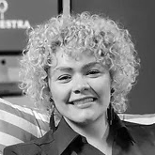
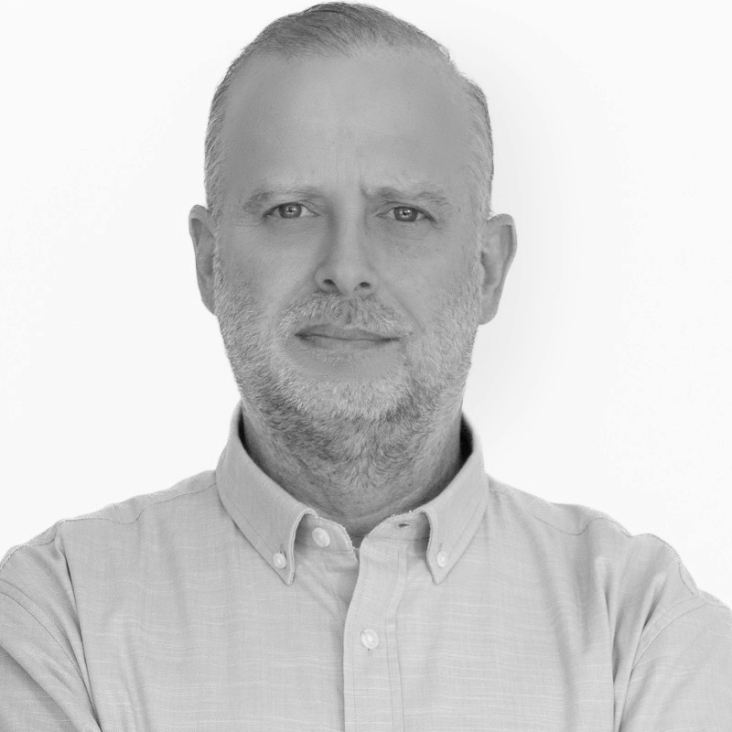
Mentors
Marcelo Lebendiker is a businessman, investor and entrepreneur. He founded ParqueTec in 2004, a business incubator that promotes the development of startups and entrepreneurs to be part of their stories through mentoring and support.
Ron Oliver was ranked among the top 10 innovation leaders in LATAM 2021, he has more than 20 years of experience in business development and startup management. He is an ambassador for Base Miami in Colombia and Mexico. In addition to being a mentor, angel investor and speaker. His goal is to promote the development of companies and turn them into success stories.
Omar Morales has a degree in International Business, with expertise in entrepreneurship process management training. His talent allows him to be able to evaluate and find the gaps to make a business viable. He is also the director of Scalelat in Mexico.
Carolina Arango is an expert in innovation and exponential technologies with more than 12 years of experience in accelerated growth of startups and SMEs in Latin America. She holds a Master of Science (M.S.C) from Cambridge Business School and is a graduate of Singularity University. She is also Founder and CEO of Orchestra Global, an SME that seeks to design and improve governance models based on data and philanthropy.
Daniel Dron is a specialist in the development of new businesses linked to innovation and education. His almost 20 years as an entrepreneur have allowed him to work in many regional projects in Latin America related to training focused on new technologies. And if this were not enough, he likes to share his knowledge through conferences.

Slide 13
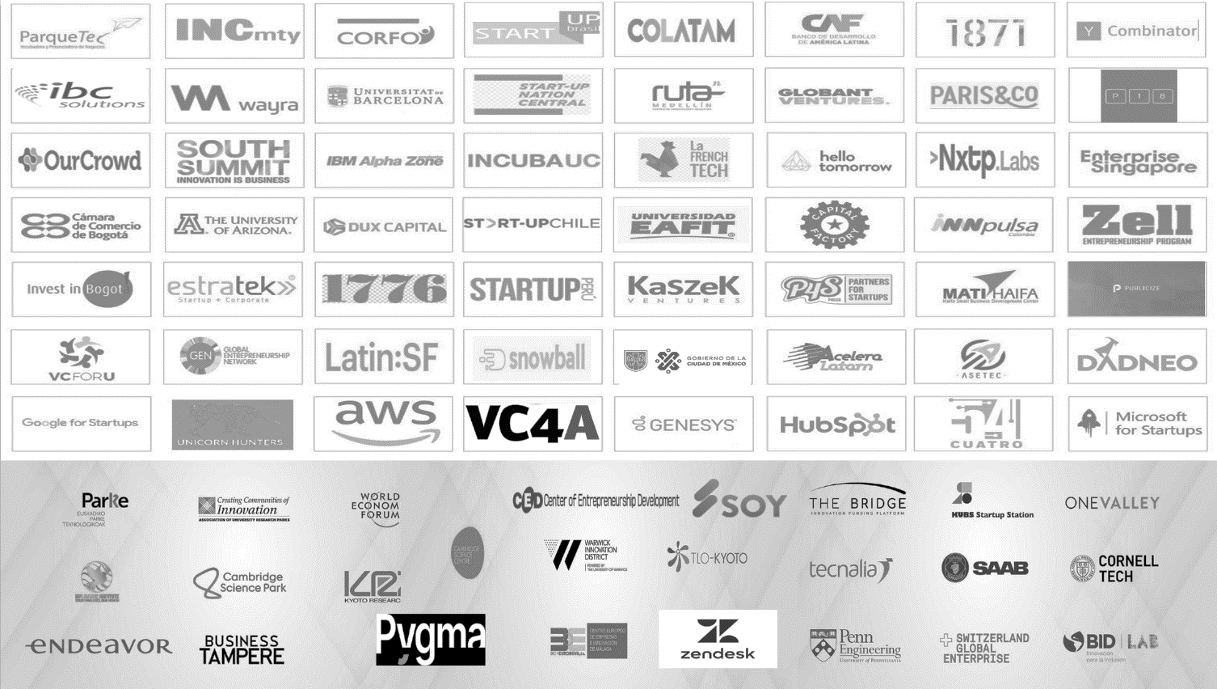
Partners

Slide 14
Contact
More information:
RON OLIVER CoFounder y CEO Parque Tec Mx
Mail: oliver@parquetec.org
Tel/WhatsApp: +52 55 6137 0808
https://www.parquetec.org

